Slide 1
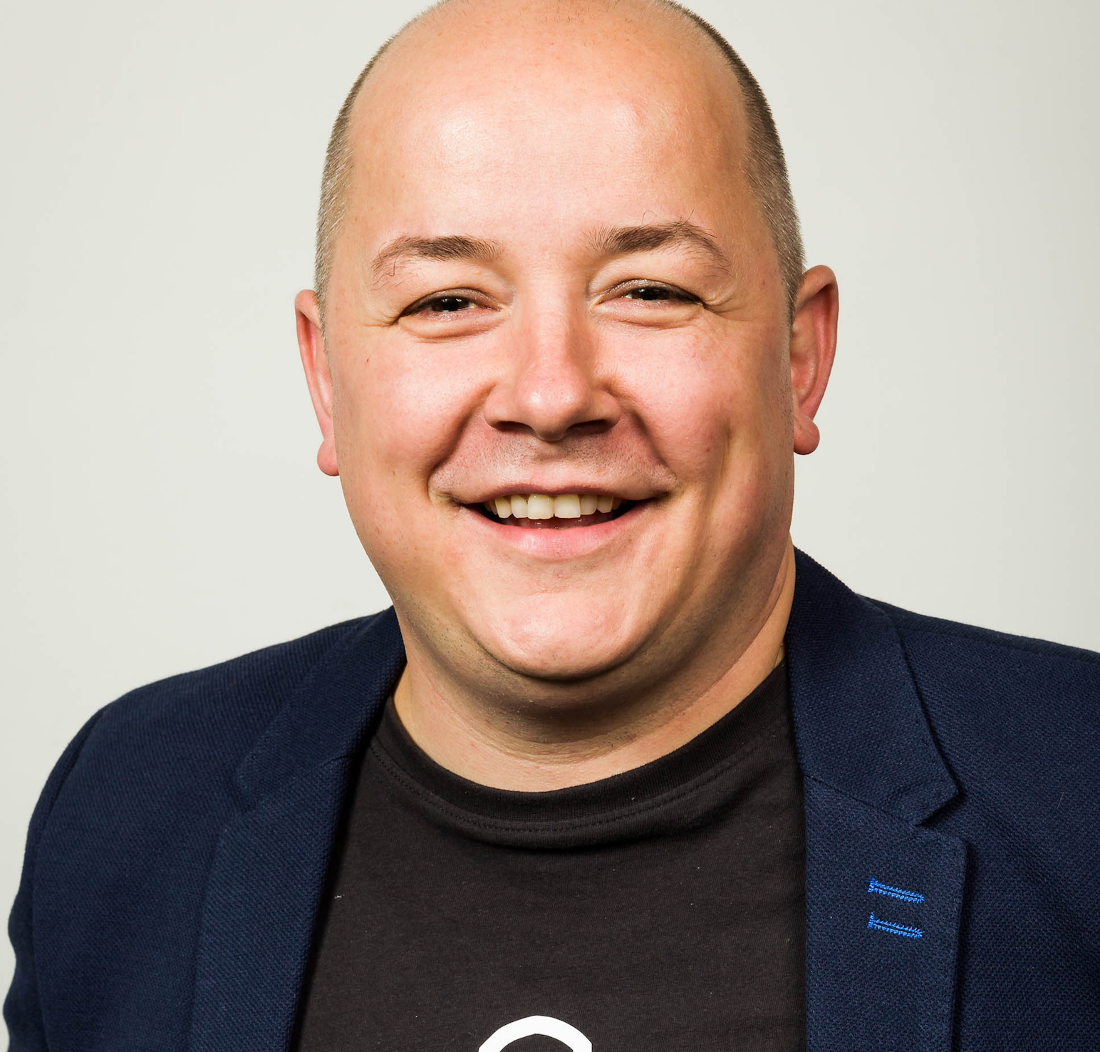
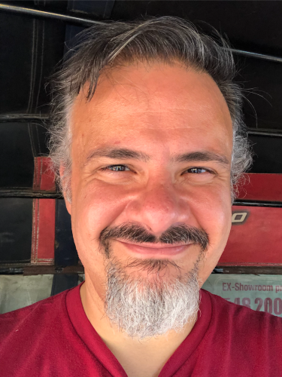
Learning Lab: Unleash Your Inner Security Champion
LAB3-W10
Pieter Danhieux CEO and Co-Founder, Secure Code Warrior pd@scw.io
Jim Manico CEO, Manicode Security
jim@manicode.com

Slide 2
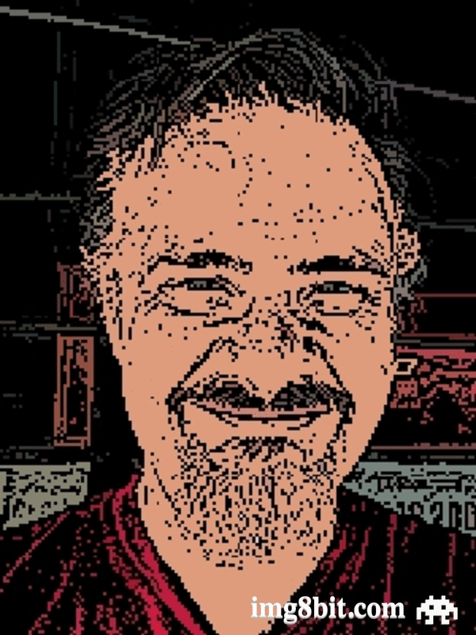

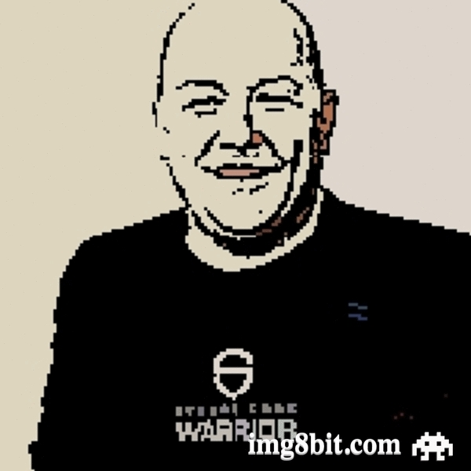
The fight against bad code.
Notes:
Pieter brief intro/why he fell in love with security
Jim brief intro/why security is cool/the future/etc.

Slide 3
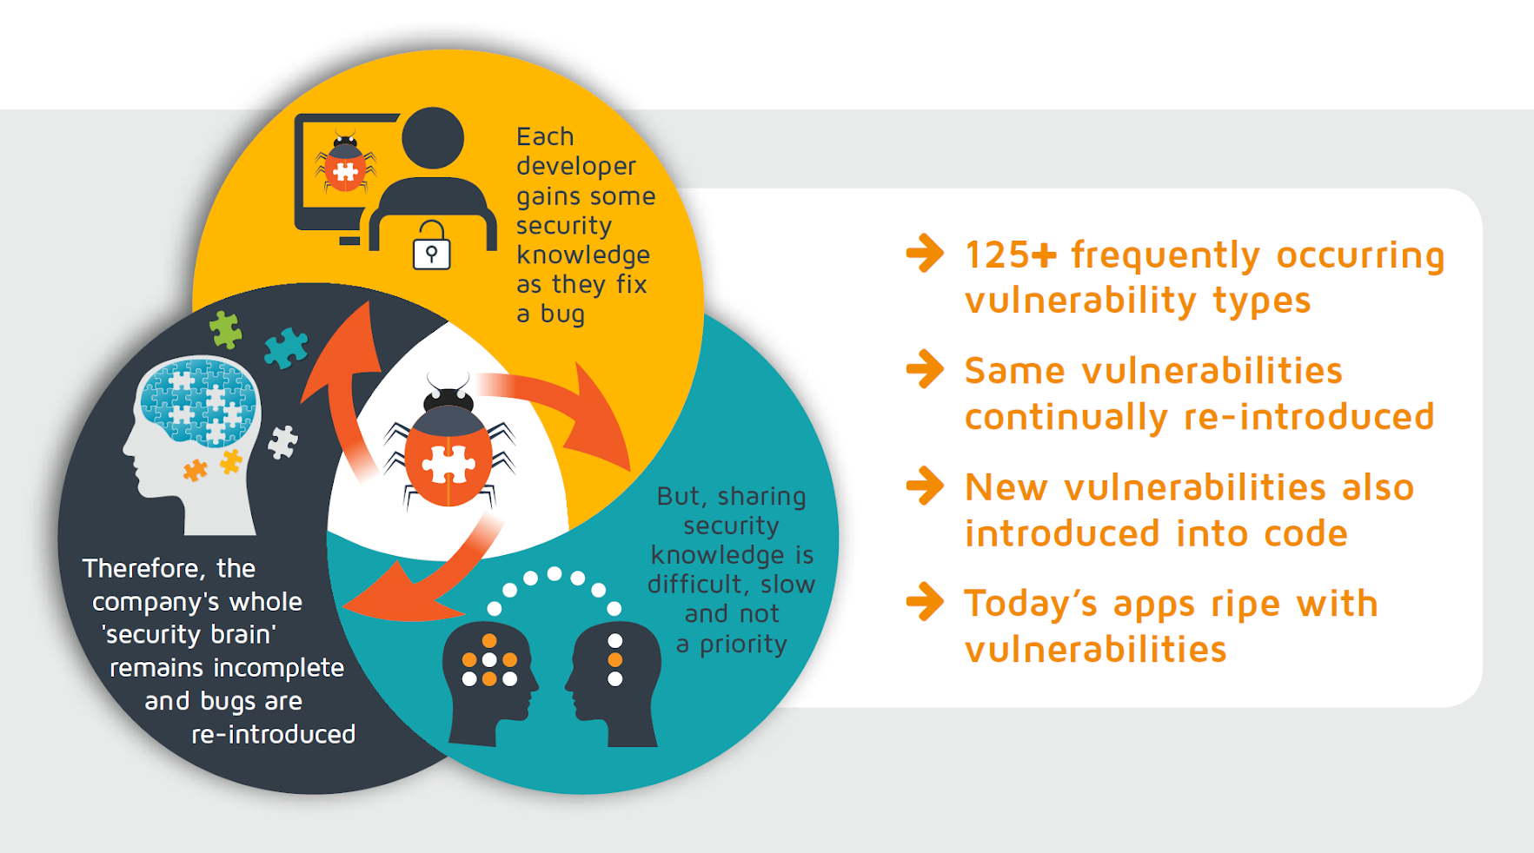
Why aren’t we learning from our mistakes?
Notes:
According to the NIST (National Institute of Standards and Technology, US Dept. of Commerce), there are 125 frequent occurring vulnerabilities.
Each developer of the team can not master how to tackle all these vulnerabilities (think juniors).
Developers work on different bits of the code so security knowledge and best practices need to be shared (hard as class room style training and wiki’s aren’t effective, , time consuming, not a priority).
New developers join and need to be trained on best practices, developers leave (is their knowledge preserved?).
Once a vulnerability is fixed, the ‘how it was fixed’ isn’t typically shared or if shared it is done in wiki’s, confluence etc.
Big chance vulnerability will be reintroduced: again research on how to fix or even worse a different fix (new library f.e.).
All the above cause security bugs to be present and hard to eradicate.

Slide 4
Be the hero we need.
With the right skills, tools and support, developers can be the first line of defense in their organisation.
They have the power to drive and maintain a positive security culture, keep best practice highly visible and write secure code from the beginning.

Slide 5

“Shift left” is dead.
By the power of Grayskull security awareness and action, you can upskill and make serious IMPACT as a security-aware developer.
With your help, organizations can finally start left in the SDLC.

Slide 6
It’s time to play a game.

Slide 7
ACCOUNT REGISTRATION
1
WiFi: XXXX PASSWORD: XXXX
2
GO TO: https://discover.securecodewarrior.com/2020RSA.html
3
FILL IN YOUR DETAILS AND YOU WILL BE DIRECTED TO LOGIN
Notes:
Any trouble logging in- go to portal.securecodewarrior.com and use registration key 628948897467

Slide 8
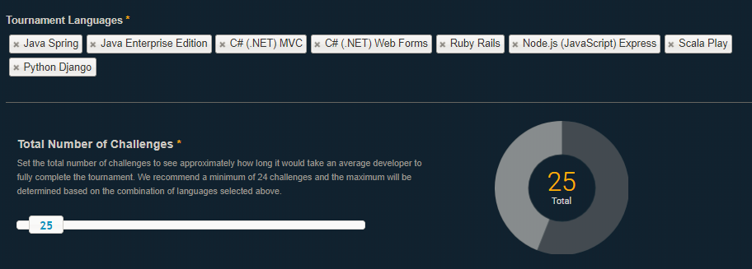
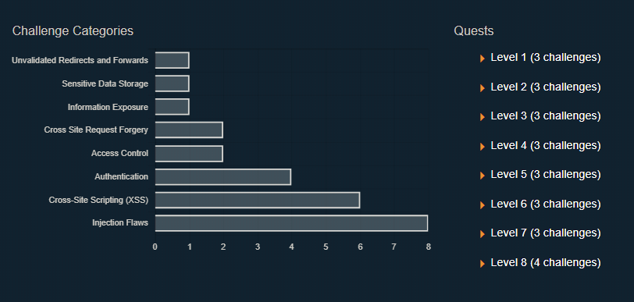
CHALLENGES

Slide 9
TYPE OF CHALLENGES
All challenges are based on the OWASP Top 10 and require participants to either:
Identify a particular vulnerability within a block of code
Locate a named vulnerability within a block of code
Fix a vulnerable piece of code
+ Combinations of any two of the above
Registration Link: https://discover.securecodewarrior.com/2020RSA.html

Slide 10
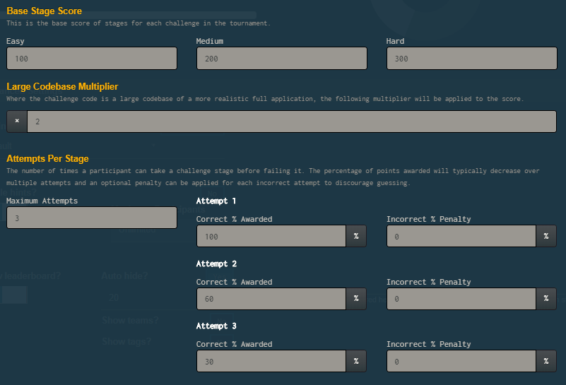
SCORING & ATTEMPTS
EARNING POINTS
LIVES LOST

Slide 11
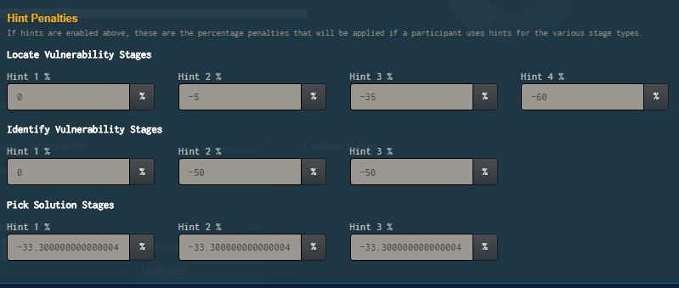
THE “COST” OF USING HINTS – Your Mileage Varies
Use these to learn more about each vulnerability
THEY’RE FREE!

Slide 12
HOUSEKEEPING
You will have ~60 minutes to complete.
Stick around for the winners announcement and prizes!
Tweet, tweet and keep on tweeting: @SecCodeWarrior
Registration Link: https://discover.securecodewarrior.com/2020RSA.html

Slide 13
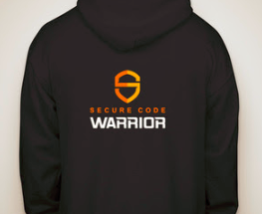
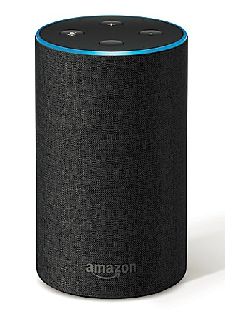
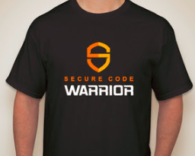
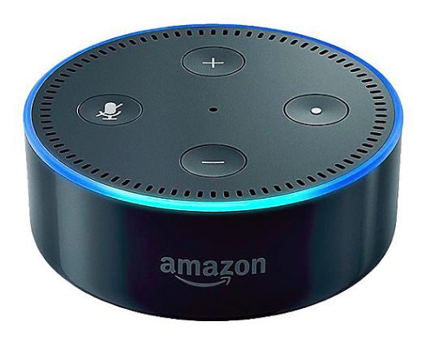
PRIZES
WAIT! THAT’S NOT ALL….
Registration Link: https://discover.securecodewarrior.com/2020RSA.html

Slide 14


THE FIRST PLACE WINNER GETS 2 PASSES* TO LOCOMOCOSEC CONFERENCE IN HAWAII!….
Registration Link: https://discover.securecodewarrior.com/2020RSA.html
*Passes only. Travel not included.

Slide 15
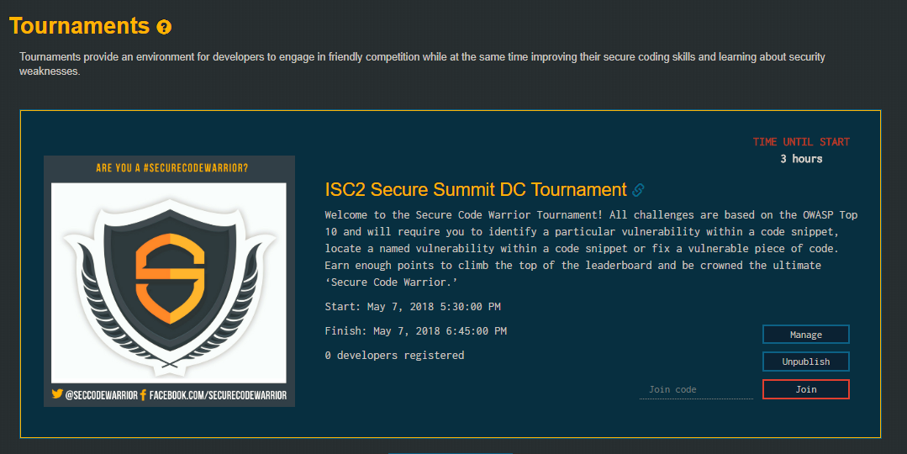
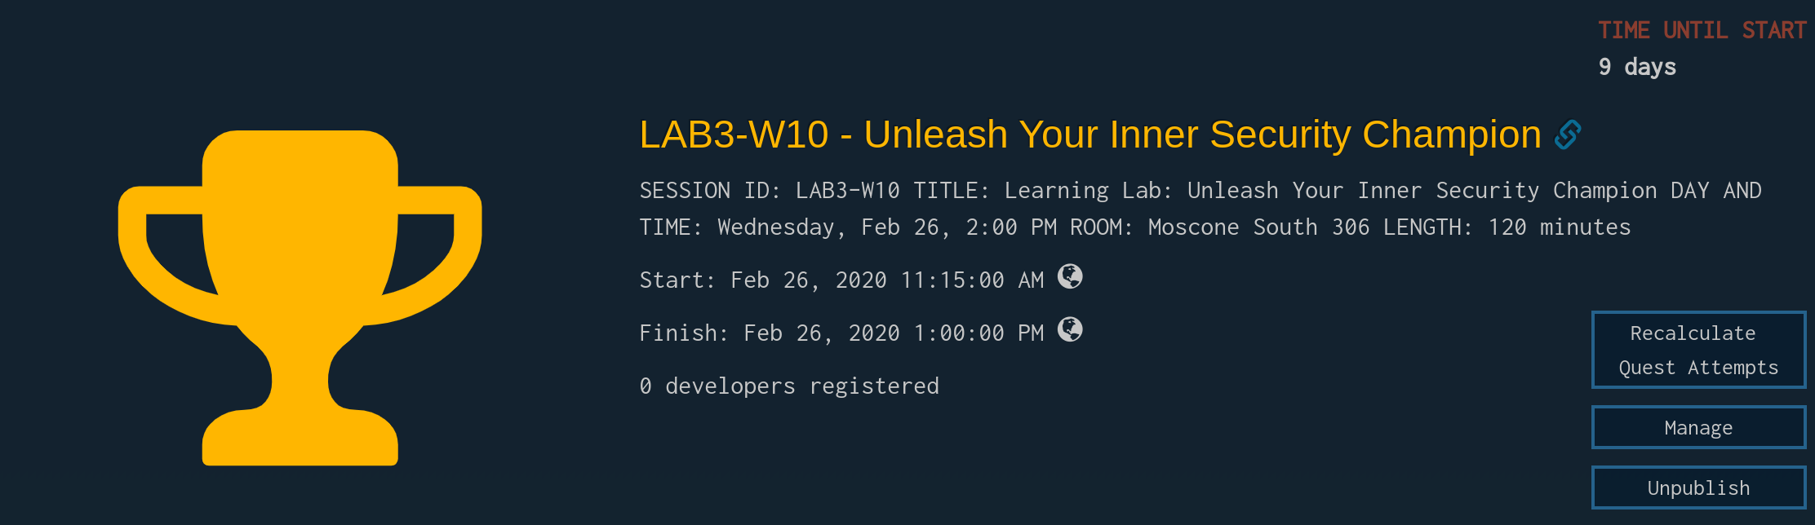

LET’S DO THIS!
Registration Link: https://discover.securecodewarrior.com/2020RSA.html

Slide 16
PSST... DON’T FORGET TO HAVE SOME FUN!
RSA2020$#!
Registration Link: https://discover.securecodewarrior.com/2020RSA.html

Slide 17
FORGETTING SOMETHING?
1
WiFi: XXXX PASSWORD: XXXX
2
GO TO: https://discover.securecodewarrior.com/2020RSA.html
3
FILL IN YOUR DETAILS AND YOU WILL BE DIRECTED TO LOGIN
THE TOURNAMENT WILL GO LIVE AT 2:15PM AND WILL END AT 3:15PM

Slide 18

>> Is your brain full yet?

Slide 19
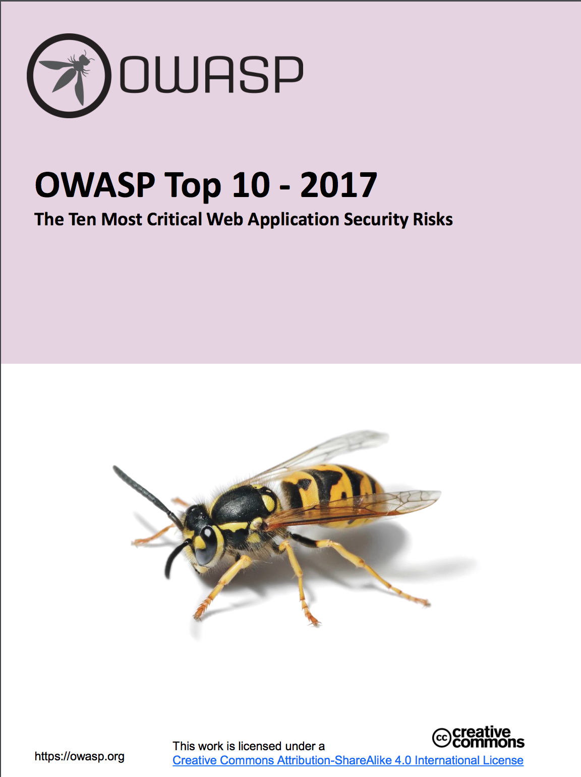
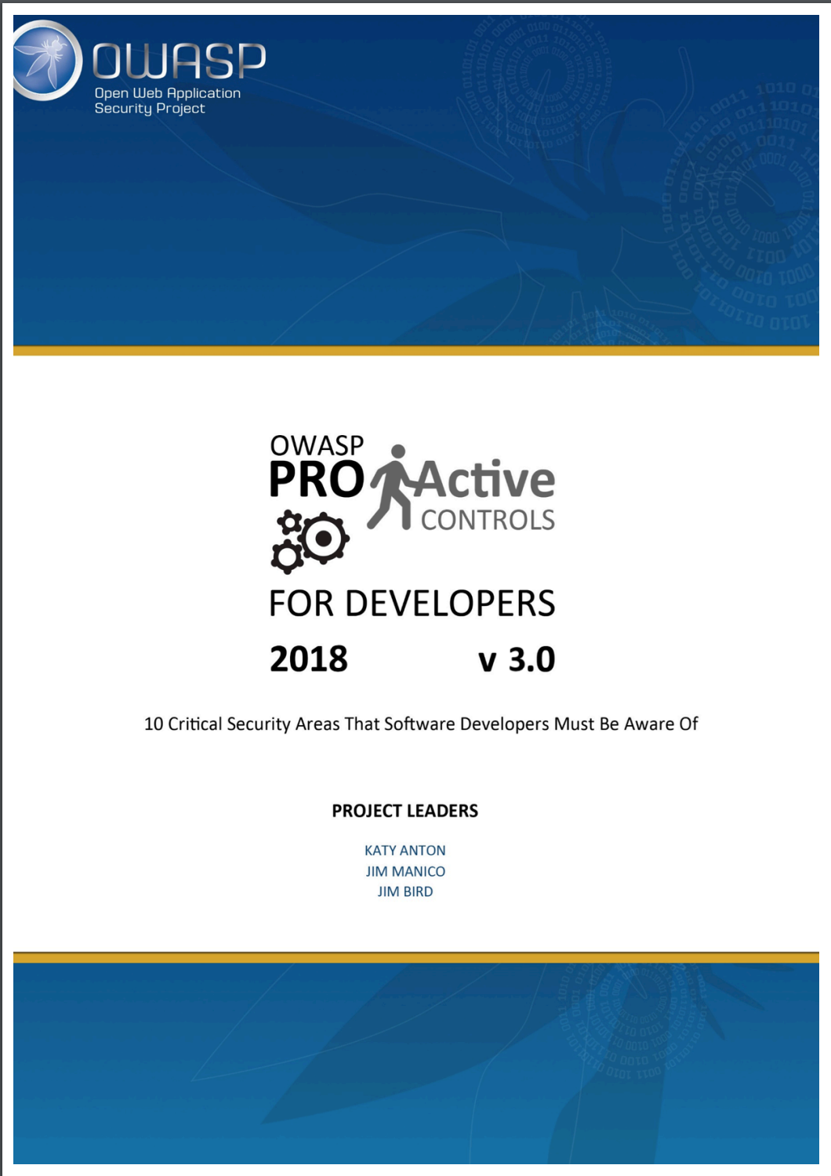
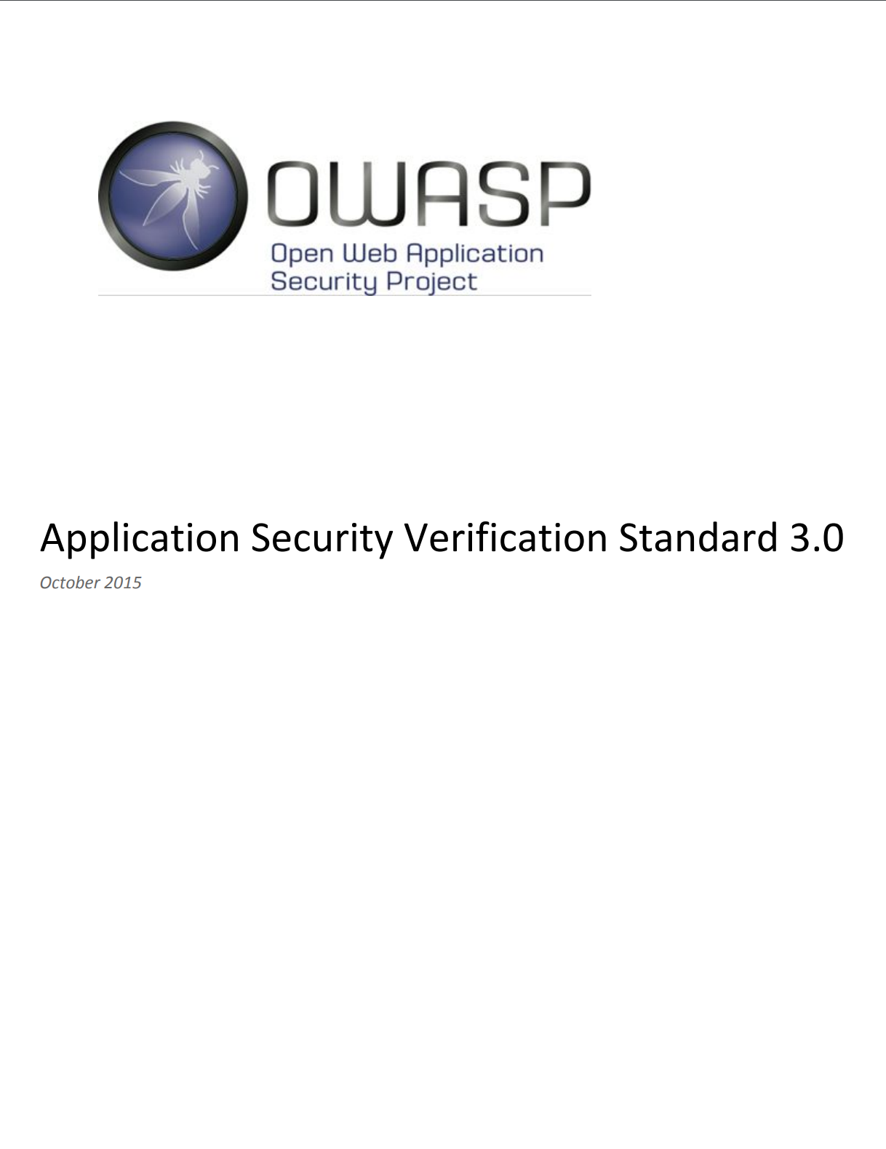
Weaknesses vs Controls
Notes:
We as an industry need to stop focussing on negatives but make sure secure foundations can be built
Don’t tell them what NOT to do, provide guidance on what to needs to be done to achieve success

Slide 20
An amazing security culture takes time… but it’s worth it.
01
02
03
Dependency management
Create/follow secure coding guidelines
Build relationship with application security team

Slide 21
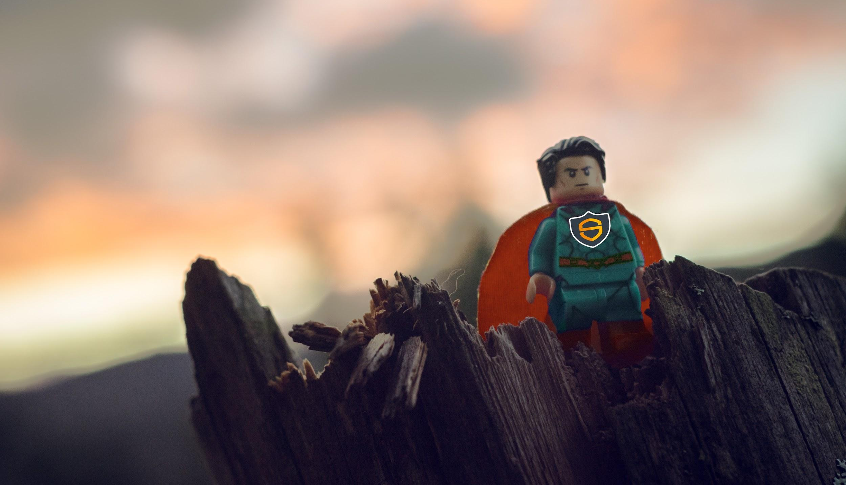
Takeaways:
You have the power to create better outcomes in security testing
Distribute knowledge to scale AppSec
Define good patterns and re-use
Put some fun and positivity into everything
Secure Developers Are Heroes
Notes:
We want to turn developers into heroes.

Slide 22
How to apply what you’ve learned today:
Next week you can:
Brag about your score to other devs
Keep playing on your free trial
In the first three months following this learning lab you should:
Get a feel for the security culture in your workplace: is it healthy?
Approach projects with more security awareness, especially in identifying common vulnerabilities
Within six months you should:
Further your knowledge in security, test your skills, keep the conversation going
Take your crown as the team security champion :D

